Slide 1
The
Nobility
of
Policing
Adapted from “The Nobility of Policing: Guardians of Democracy” by Michael Nila, 2008.

Slide 2
“It has always been my firm belief that policing is one of America’s most noble professions. The actions of any police officer, in an instant, can impact an individual for life, and even a community for generations. Given this realization, every police officer must be centered on what is important. Service, justice, and fundamental fairness – these are the foundational principles in which every police action must be grounded.
- Dr. Stephen R. Covey

Slide 3
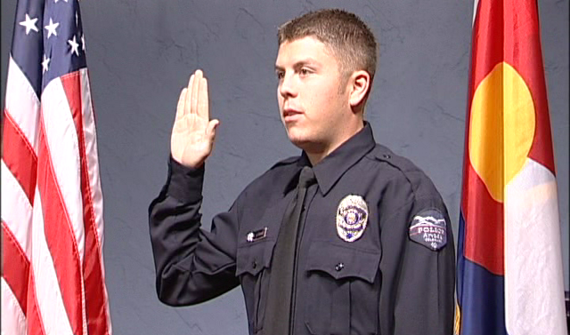
In times of great challenge, there is no greater need than for the nobility of policing to nurture and protect democracy.

Slide 4
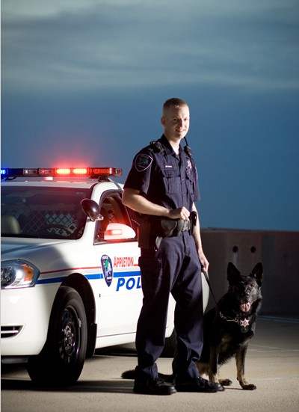
Peaceful
WARRIOR
You must always be prepared – mentally, physically, emotionally, and spiritually – for those moments when you are tapped on the shoulder and thrust into circumstances that are beyond imagination.

Slide 5
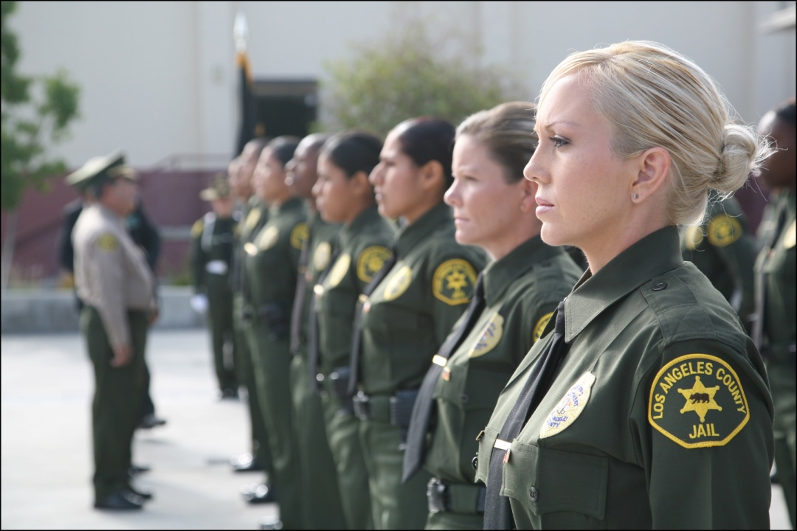
No one is compelled to choose the profession of a police officer, but having chosen it, everyone is obligated to perform its duties and live up the high standards of its requirements.
- President Calvin Coolidge

Slide 6
Critical responsibilities
To preserve freedom and uphold democracy.
To uphold the law.
To ensure justice.
To protect life.
To keep the peace.

Slide 7
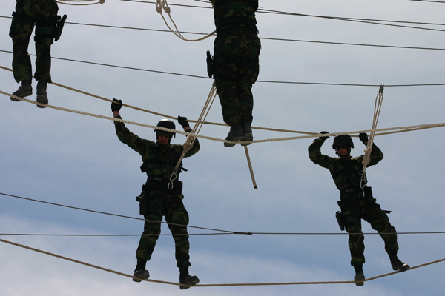
If you choose law enforcement, you lose the right to be unfit.
- Banner hanging in the Illinois State Police Academy

Slide 8
BEING FIT
Mind
Body
Spirit
Heart
Being “fit” means acting within the scope of our authority and with fundamental fairness in mind. It means putting our personal views aside and acting with the parameters of the law without prejudice and bias.
- Lt. Kristen Ziman, Aurora, IL, Police Department

Slide 9
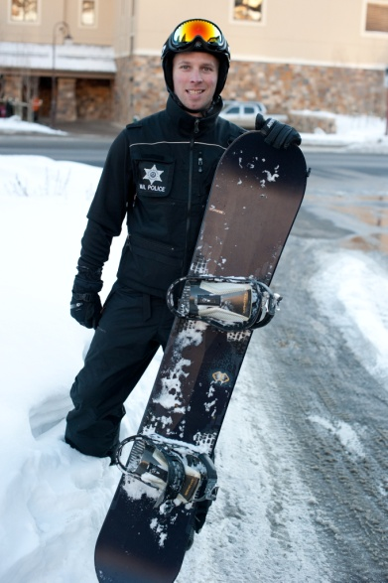
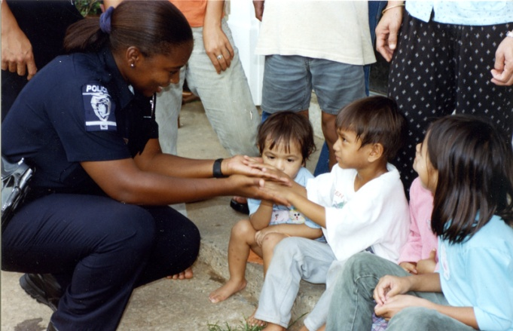
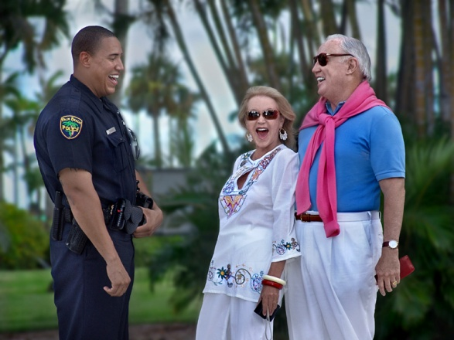
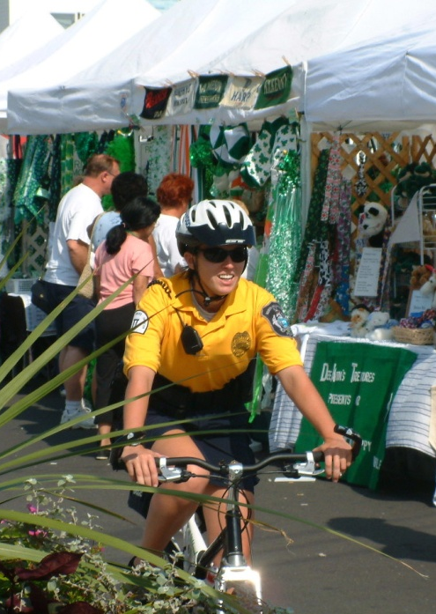
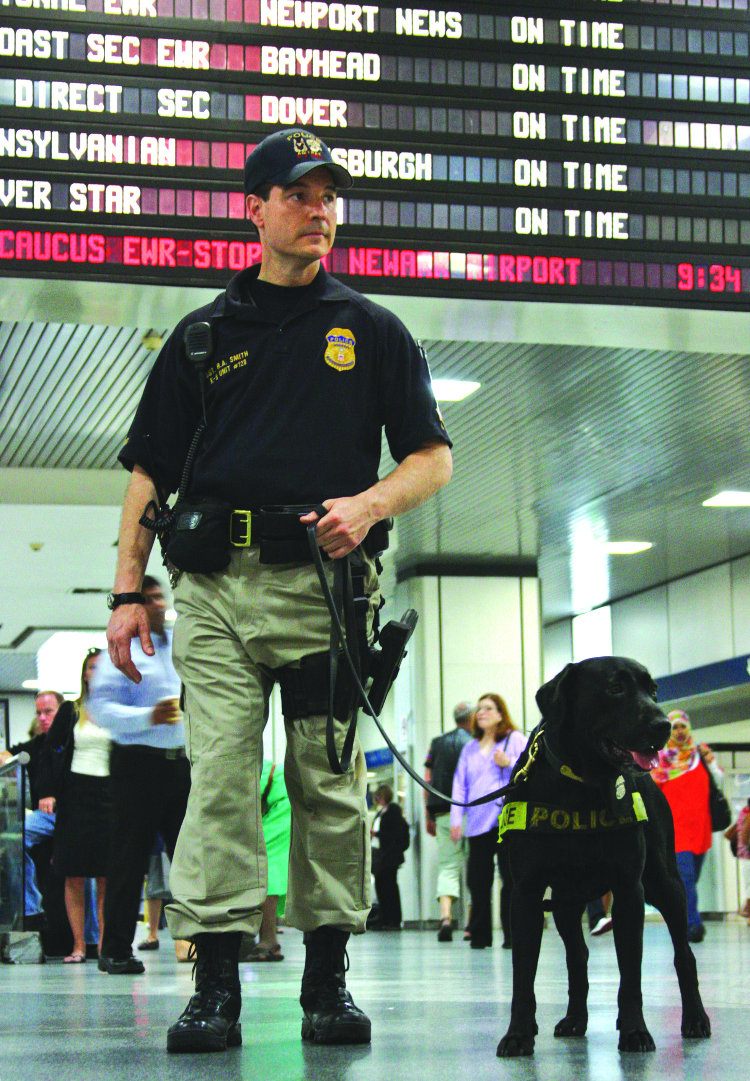
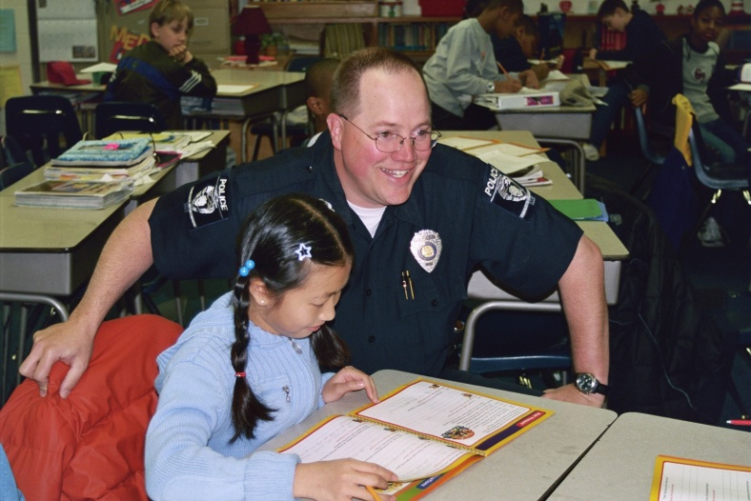
What you do every moment, of every day, touches lives.

Slide 10
Policing is
MORE!
Caring more than other think is wise.
Risking more than others think is safe.
Believing more than others think is practical.
Expecting more than others think is possible.

Slide 11
Policing is a
NOBLE
Profession.
Are you ready to be a part of it?
Are you ready to Discover Policing?
www.discoverpolicing.org
Thank you to Michael Nila and the late Stephen Covey for their contributions to law enforcement.

