Slide 1
The
Law enforcement oath of honor
Adapted from the Law Enforcement Oath of Honor Video produced by IACP and LETV.
View the video here: http://www.youtube.com/watch?v=uUDczg27Fl4&feature=share&list=UUY6ahcARglFVAkevrgtBNcg

Slide 2
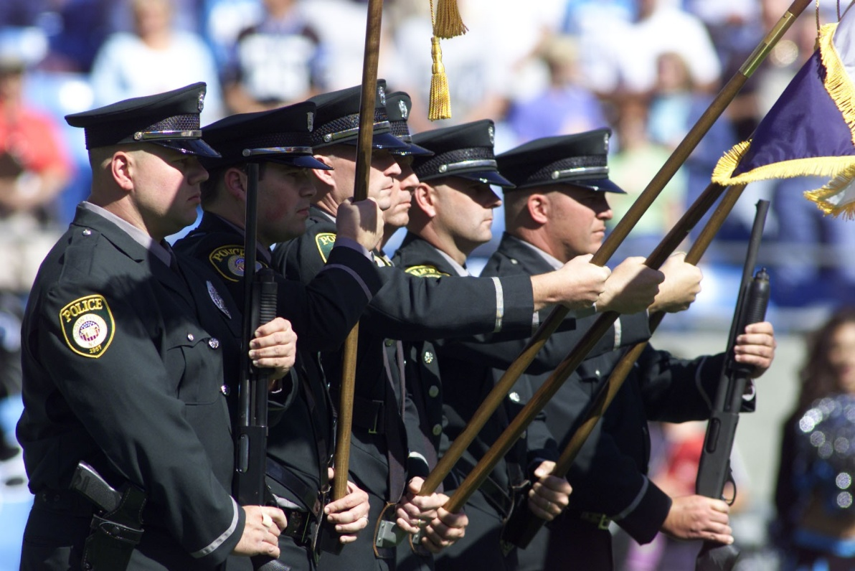
There is a reason why many communities refer to their police forces as “Our Finest.”

Slide 3
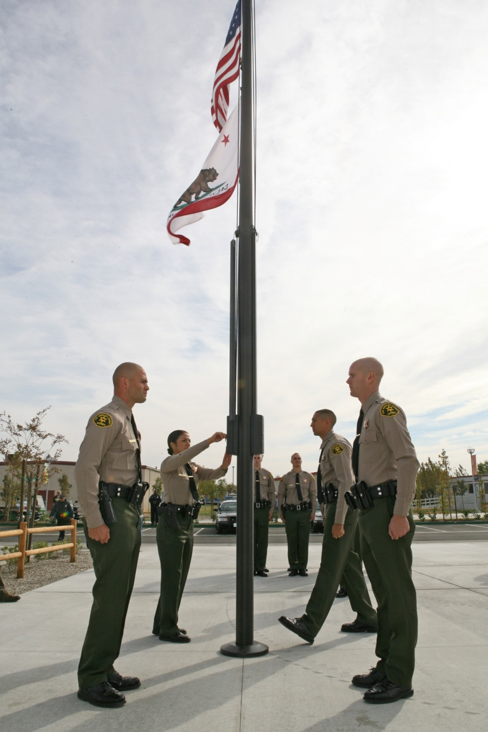
Standards should and must be higher for the individuals given the power, authority, and responsibility of a sworn officer.

Slide 4
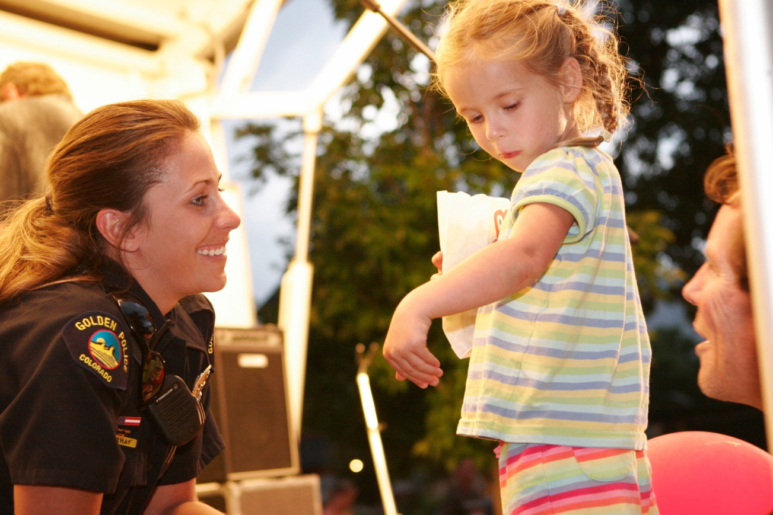
Law enforcement personnel should willingly accept the responsibility to be a role model for ethical behavior

Slide 5
Key words in the oath of honor

Slide 6
HONOR
Giving one’s word as a bond or guarantee

Slide 7
betray
A breach of faith and proving to be false

Slide 8
integrity
Firm adherence principles in both public and private life

Slide 9
character
The qualities and standards of behavior that distinguish and individual

Slide 10
Public trust
The duty imposed in faith to those who are sworn to serve

Slide 11
courage
Having the mental and moral strength to venture forth, preserve, withstand, and overcome danger, difficulty, and fear

Slide 12
Accountability
Being responsible and answerable for our actions

Slide 13
community
The citizens of the jurisdiction we serve

Slide 14
Oath of honor
On my honor, I will never betray my profession, my integrity, character, or the public trust. I will always have the courage to hold myself and others accountable for our actions. I will always uphold the laws of my country, my community, and the agency I serve.

Slide 15
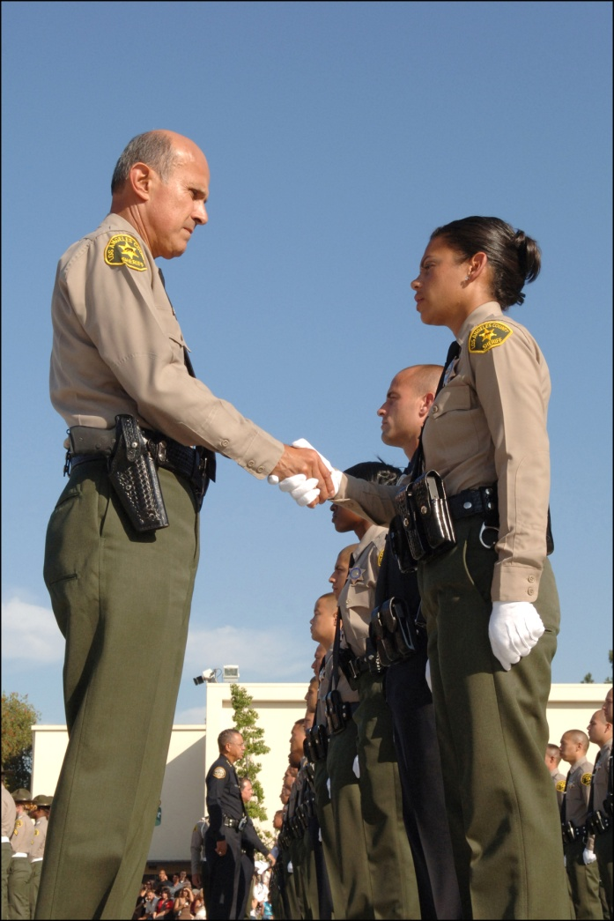
To learn more about policing visit
www.discoverpolicing.org.

