Slide 1
Discovering a Career in Law Enforcement

Slide 2
Why Policing?
More than just a job, law enforcement is a service career
Law enforcement officers come from all walks of life, diversity is essential
New challenges and numerous opportunities
Qualified officers are in demand
Good salary and benefits

Slide 3
Types of Law Enforcement Agencies
Federal
State – state patrols, state bureaus of investigation
Local – city police, county sheriffs, regional agencies, tribal police
Special – school system police, transit agency police, harbor or marina police

Slide 4
Types of Jobs
Sworn
Patrol officer (bicycle or mounted patrol)
Investigator
SWAT team member
A sworn position is one that is managed the by the state POST (peace officer standards and training. Individuals in these positions typically carry a badge and a firearm and have arrest authority.

Slide 5
Types of Jobs
Civilian
Crime prevention specialist
Crime analyst
Public information officer
Civilian positions are usually limited in scope and role and have specialized skills. These individuals do not carry guns or have arrest powers.

Slide 6
What Does It Take? Skills and Abilities
Problem solving and critical thinking skills
Ability to multi-task
Capacity for empathy and compassion
Ability to demonstrate courage and take responsibility
Able to work collaboratively

Slide 7
What Does It Take? Basic Requirements
Each state sets standards that all agencies must meet or exceed
Types of requirements
Citizenship
Minimum/Maximum age
Education
Valid Drivers License
Fitness
Be aware of disqualifiers as well

Slide 8
What Does It Take? The Process
Application
Entrance exam, written or video
Physical fitness and agility test
Background investigation
Drug testing
Psychological and medical exams
Polygraph
Interview

Slide 9
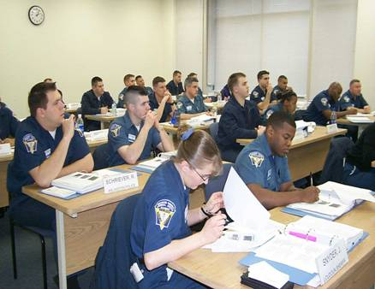
What Does It Take? Training
Academy
Field training

Slide 10
Visit
www.discoverpolicing.org
to learn more.

